Slide 1

PALACHOVY-TECHCLOUD
Semestral Project – Enterprise Informatics 2
Jesus Calleja Rodríguez, Taner Beyhan, Manuel Muñoz Marín, Jose Luis Pedraza Román

Slide 2
Introduction
Our company
Palachovy-Techcloud.
Goals: Server Rental Service
Customers: Different packages for differents types of customers
Basic-Cloud
Pro-Cloud
G-Cloud
Business Strategy: Offering different services according to the need of the customers. Seeking potential customers.
Finance statements: Initial capital investments. Donations. Agreements. Earnings with packages.
Difficulties: Be prepared to solve some problems. Conectivity, security. Maintenance of the system.

Slide 3

IT Governance Arrangement Matrix
Decision / | IT Principles |  | IT Architecture |  | IT Infrastructure Strategies |  | Business Application Needs |  | IT Investment
Archetype | INPUT | DECISION | INPUT | DECISION | INPUT | DECISION | INPUT | DECISION | INPUT | DECISION
Business monarchy |  | IT MANAGERS |  |  |  |  |  | IT MANAGERS/BUSINESS TEAM |  | IT MANAGERS/FINANCIAL MANAGEMENT
IT monarchy |  | IT MANAGERS | Outsouerced art.team | IT MANAGERS |  | FINANCIAL MANAGEMENT | SE-DE-MANAGEMET | IT MANAGERS |  | FINANCIAL MANAGENT
Feudal |  |  |  |  |  | BUSINESS TEAM
Federal |  |  |  |  | INVESTORS | BUSINESS TEAM |  |  |  | FINANCIAL MANAGEMENT
Duopoly |  | RE-DE MANAGEMENT/IT MANAGERS |  |  |  |  |  |  |  | FINANCIAL MANAGEMENT

Slide 4

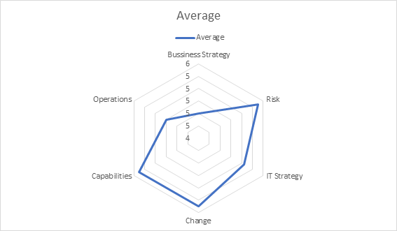
IT Governance questionnaire

Slide 5
Graphical results
In conclusion, although there is apparently a deficit in the value of the business strategy graph, this is compensated with good results in the field of changes in our chart.
The hight value of risk is due to our directors know perfectly the impacts of IT Governance on the work and personnel of the company, we obtain a correct management of
strategies and our intellectual capital.

Slide 6

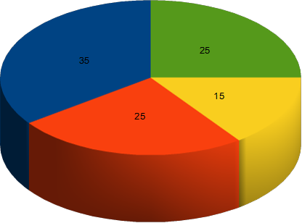

Investment portfolio

Slide 7

Graphical results
Informational: We are providing a informatical service so we need a hight percentage.
Strategic: We usually would like to increase the capacity of the system according to
the needs of our services.
Transitional: We have to stand our expenses ambitiously buying from external
companies.
Infrastructure: We need a huge infrastructure for our services.

Slide 8
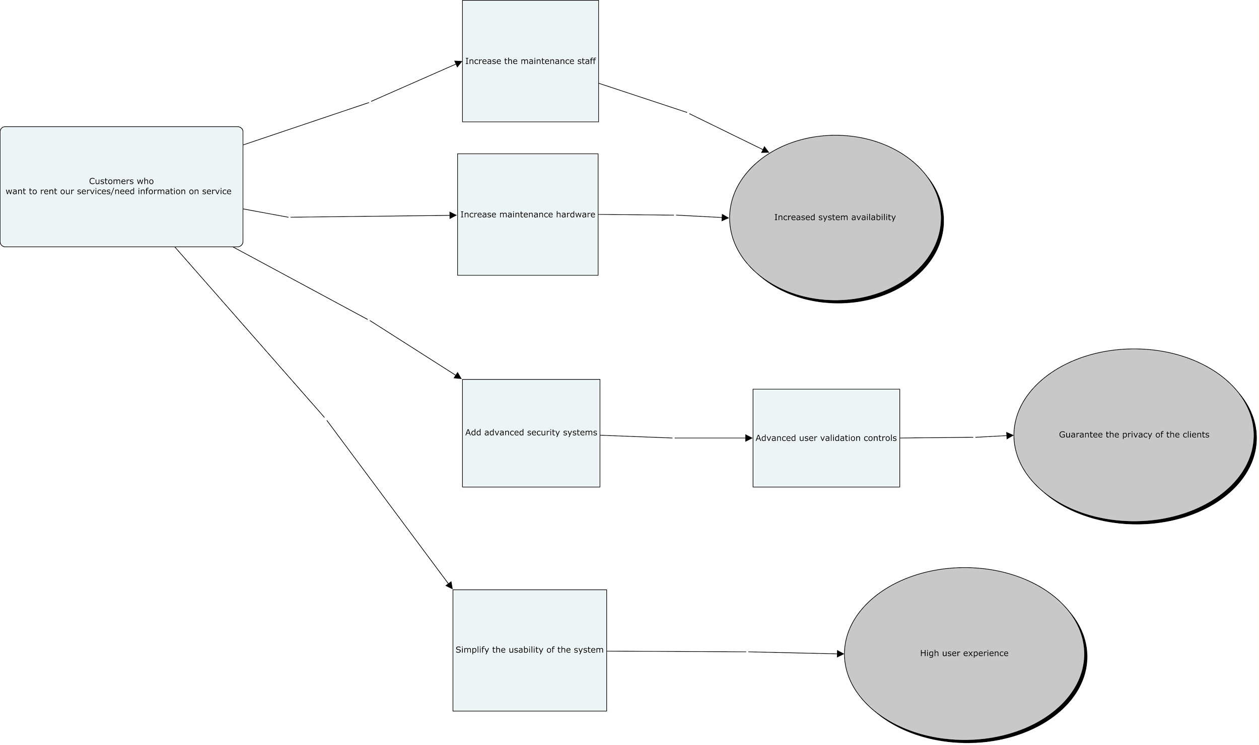
Results chain

Slide 9
Process evaluation using maturity models
Level 0 – Initial: Focus on keep privacy of people safety. Hard work to ensure continous availabity of the system.
Level A – Repeatable: Provide the service continuosly also for the customers. Repeat the information because we are not able to find new customers.
Level B – Defined: Involving the implementation of the system somehow.
Level C – Managed: Infrastructure made by partners and investors sharing all the information.
Level D – Optimizing: Follow the trends of technology for being pioneers in the sector.

Slide 10

Service desk implementation
Provide contact constantly with our customers.
Having a channel for communication.
Allowing good integration of employeers.
Facilitating access to data.
Doing reports monthly.
Easy way of incorporating new suppliers and partners and allowing them to abandon it in an easy way.

Slide 11
Establishing helpdesk
In the most of days, We had been struggling with getting knowledge from helpdesk which can be helped our stuff such as copy center, working with IT department, relating to access login page on our website.

Slide 12
SLA preparation
Interface | Availability | Hours to Measure
Telephone | 50 % | During Work Hours
E-mail | 100 % | During week days
Web Portal | 95 % | At All Times
SLA preparation is a way to provide a service between customers and the company
Service hours
Service must be available from 9:00 AM to 10:00 PM, Monday through Friday
Service avability

Slide 13
Service Reliability
Priority | Description | Target Resolution Time
1 | Critical | 1 hour
2 | High | 8 hours
3 | Medium | 24 hours
4 | Low | 48 hours
5 | Planning | Planned
The following questions can be asked to the customers after the business has done;
1-Did we really solve the problem which were not able to solve ?
2-What can you say about the company?Did you satisfy?
Service Performance

Slide 14
 |  | Impact
 |  | High | Medium | Low
Urgency | High | 1 | 2 | 3
 | Medium | 2 | 3 | 4
 | Low | 3 | 4 | 5

Slide 15

Thanks for your attention

